Slide 1
Software Innovation Studio
Team
Graphics created by Ullupta conecum re volupta evelignis pe et doluptuam.

Slide 2
Recyclenator
Recycle em, Reuse em, Stick em in the bin

Slide 3
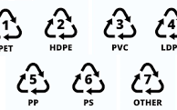
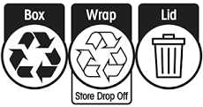
Project Scope (What)
RecycleNator employs advanced machine learning to distinguish Resin Identification Codes from recycling symbols, frequently misinterpreted, in order to ascertain an item's recyclability. It subsequently provides personalized recycling instructions, facilitating environmentally conscious choices.
It is currently limited to the laws of NSW, and to scalable web app which will be accessible on any device

Slide 4
Background Research and Users’ Needs (why and who)
Pain Point: Users often struggle with identifying whether items are recyclable due to the confusion surrounding Resin Identification Codes (RICs) and recycling symbols. This issue has been highlighted in various news articles, emphasizing the need for accurate recycling information.
There are similar solutions for mobile but we can do web and location specific

Slide 5
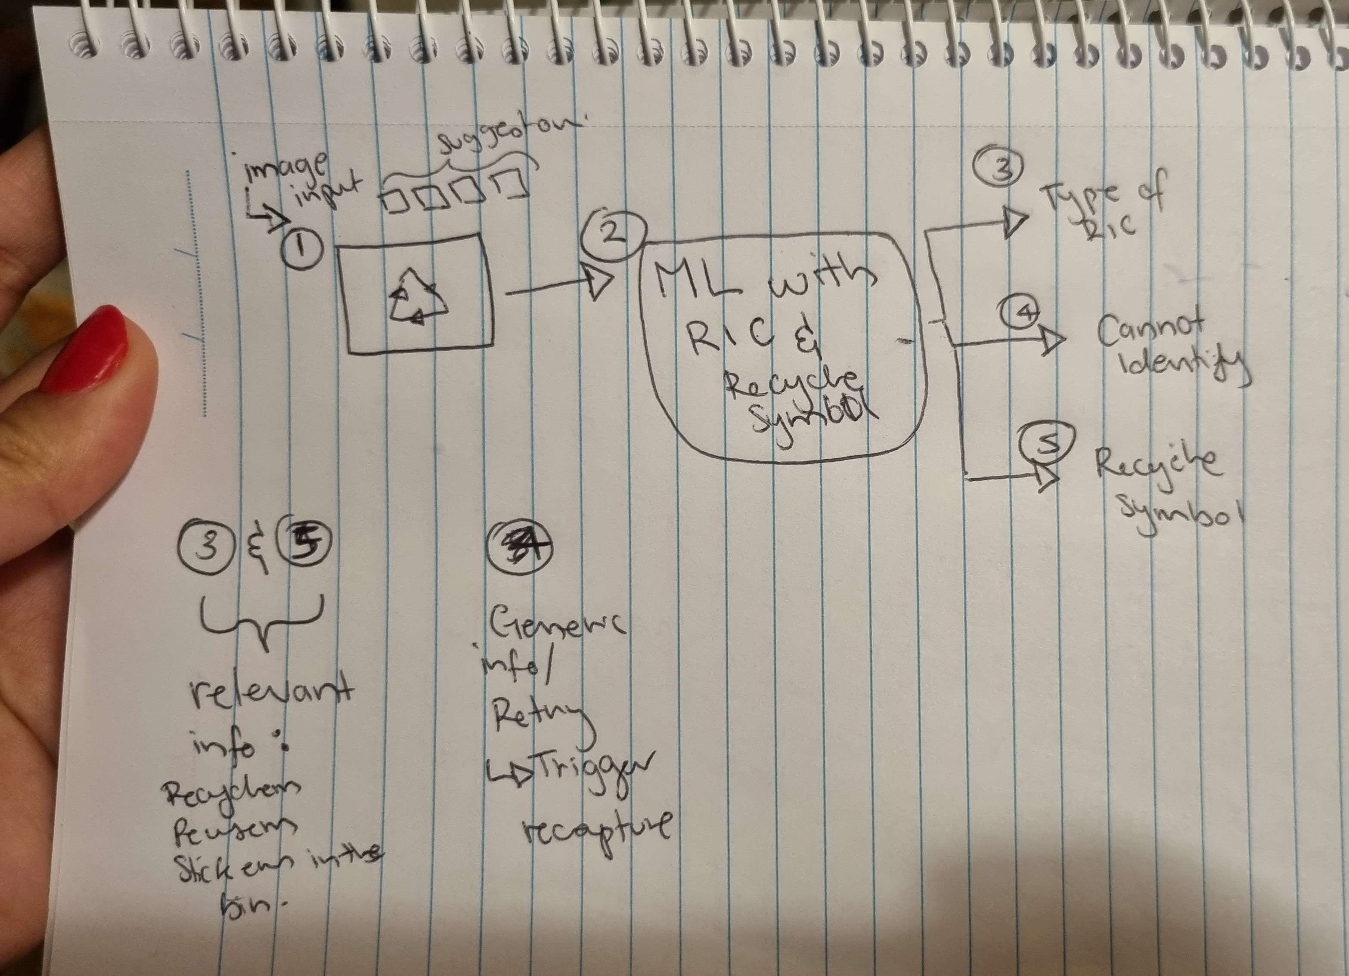
Expected Prototype / Achievements (What)

Slide 6
The Tech (How)
YOLOv8 (or similar) single shot ML

Slide 7
Your Team and Members
List the team members and their roles in this project
Link the proposed achievements with your team members

Slide 8
Project Timeline
According the proposed achievements in this semester, you should list the timeline
# of sprint should be clearly identified (>= 3 sprints)
funding plans and deliverable in every sprint
The small demo after every single sprint is expected

Slide 9
Thank you

